Slide 1
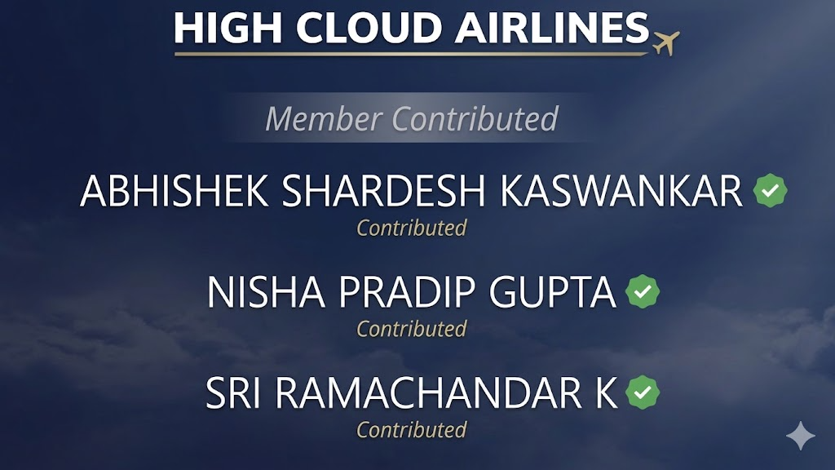

Slide 2
KPI 1
Calendar Table
Time Intelligence Framework
2008 – 2013
110,849
11
Data Period
Total Rows
Time Fields
6 Complete Years
Daily Granularity
Attributes per Row
Calendar Dimensions
Financial Dimensions
Calendar Year: Year, Month, Quarter (Q1–Q4)
Financial Year: April-start (FQ1–FQ4)
Weekday tracking: Day name & number (Mon=1)
Financial Month: April = FM1, March = FM12
Year-Month label for time-series charting
Powers all KPI 2–7 time filters & slicers

Slide 3
KPI 2
Load Factor Analysis
Yearly · Quarterly · Monthly | Formula: Transported Passengers ÷ Available Seats × 100
↑
+2.82 pp Growth
75.30% (2008) → 78.12% (2013)
☀
Peak: July 81.19%
Weakest: January 69.80%
◎
Q3 Strongest
Q3 2013 hit 80.40% (all-time high)
⬇
Seasonal Arc
Q1 Low → Q2 Rise → Q3 Peak → Q4 Drop
11.39 pp swing between best (July) and worst (January) month across all years

Slide 4
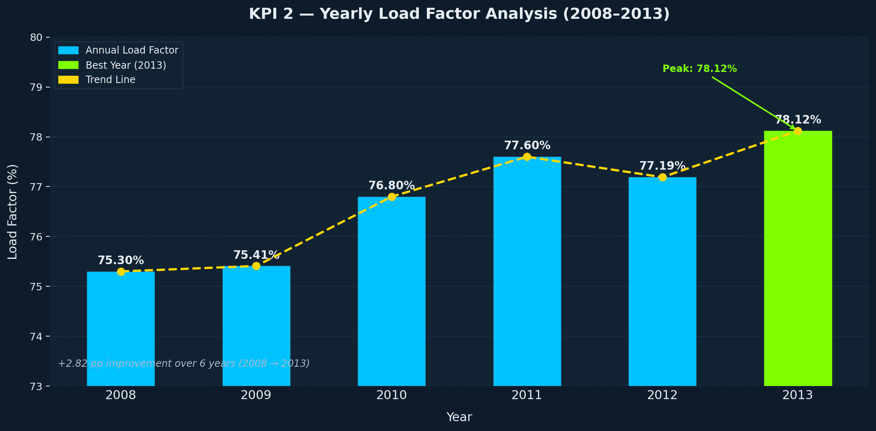

Slide 5
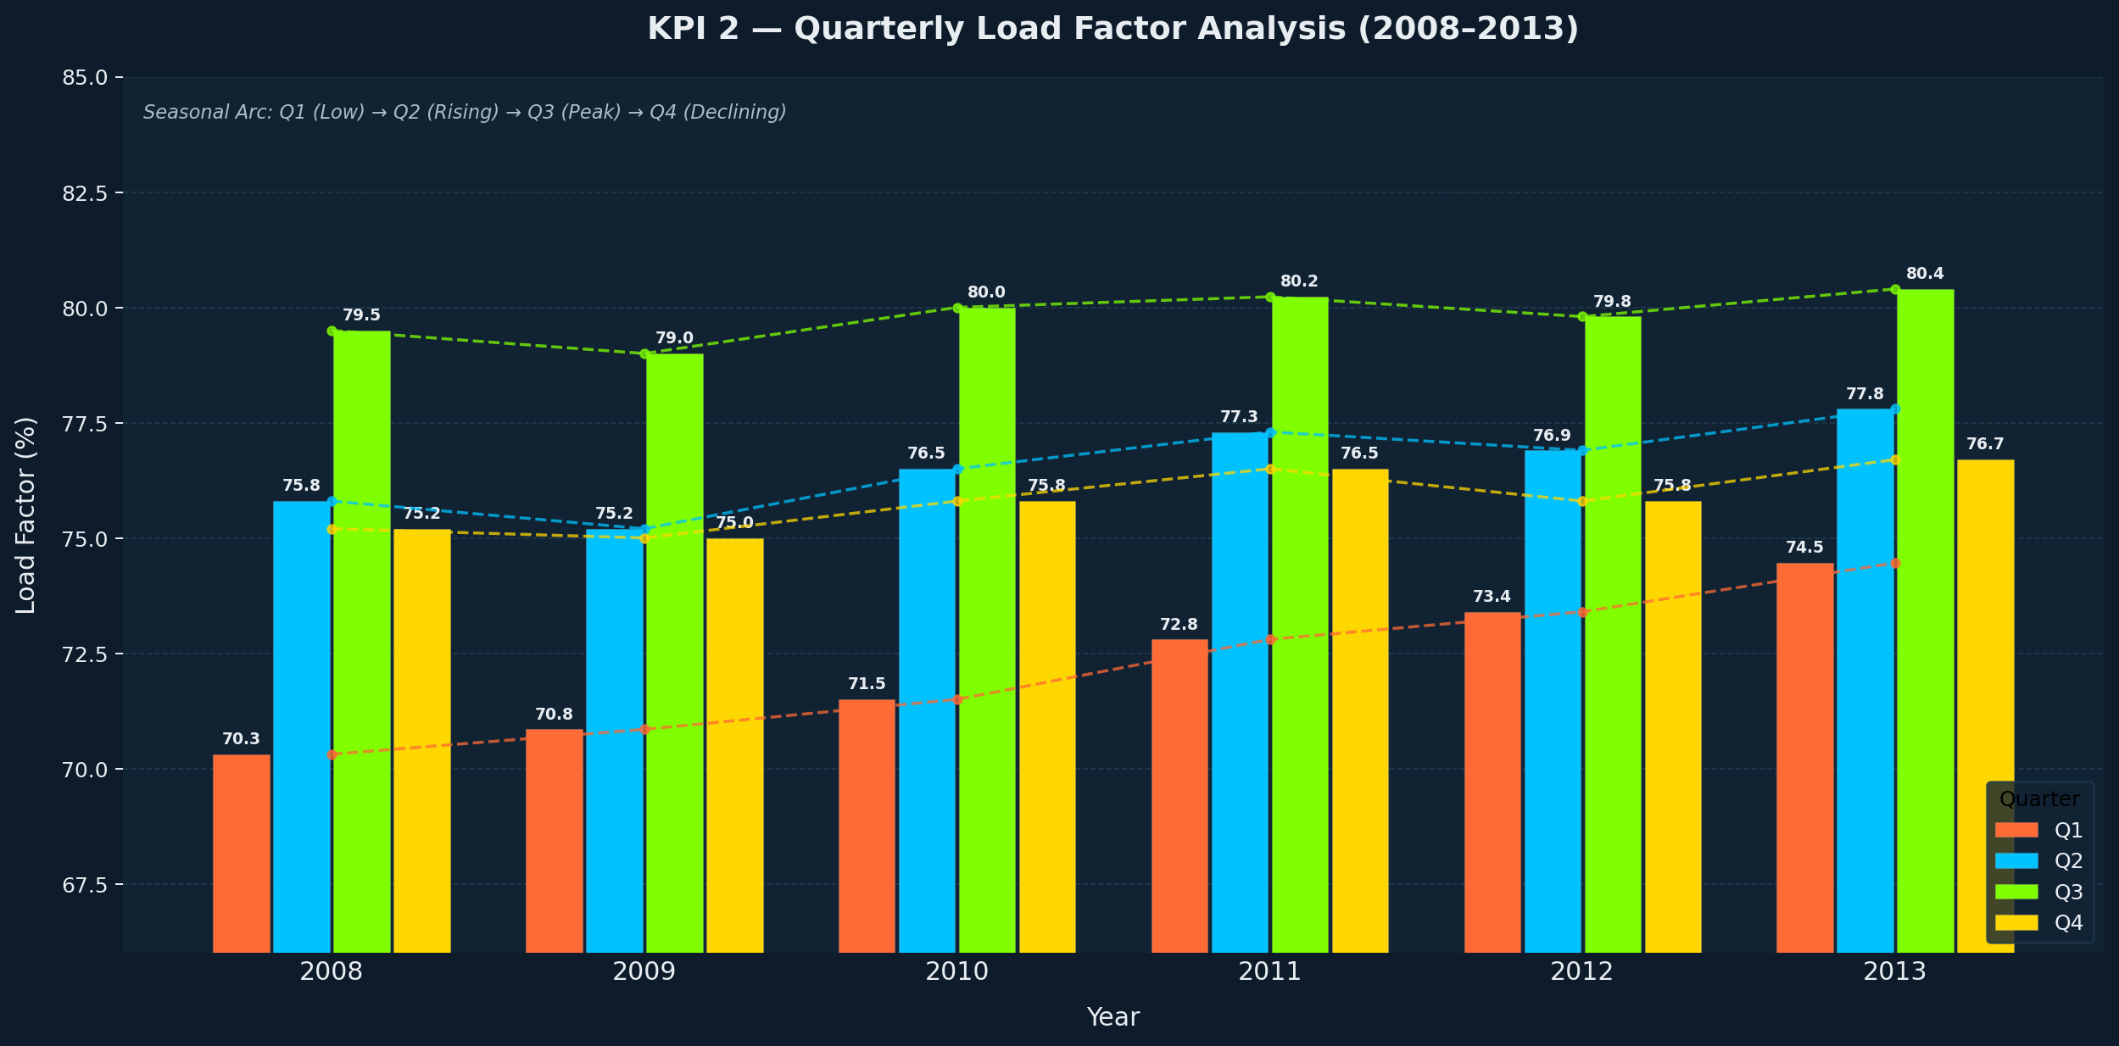

Slide 6
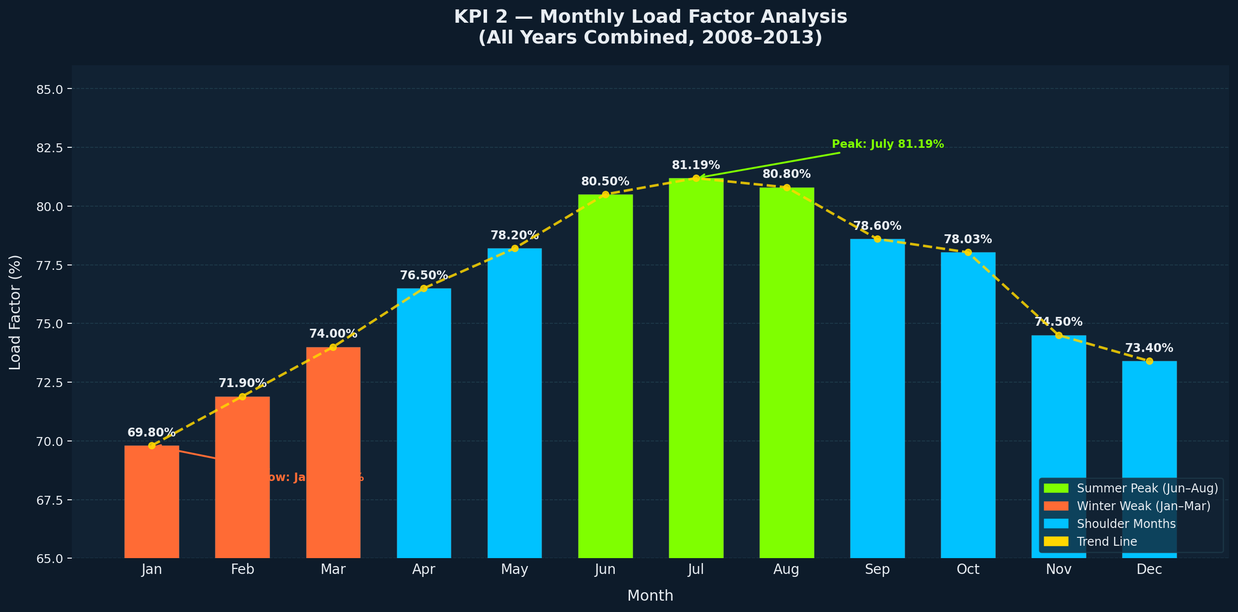

Slide 7
KPI 3
Carrier-Wise Load Factor Analysis
209 Unique Carriers | 2008–2013 | Industry Average: 83.16%
TOP 5 CARRIERS
BOTTOM 5 CARRIERS
Carrier | Load Factor
Globespan Airways | 94.76%
Allegiant Air | 89.36%
XL Airways France | 88.48%
Sichuan Airlines | 88.21%
Skyservice Airlines | 88.12%
Carrier | Load Factor
Arctic Circle Air | 1.29%
Alsek Air | 5.00%
West Isle Air | 8.86%
Ellis Air Taxi | 13.66%
National Air Cargo | 14.98%
Globespan (94.76%) — charter leisure model; bulk advance bookings
Allegiant Air (89.36%) — ultra-low-cost; flights only when seats are full
Bottom performers are remote/regional Alaskan carriers — essential service, not profit-driven
93.47 pp spread between top & bottom highlights extreme diversity of business models

Slide 9
KPI 4
Top 10 Carriers by Transported Passengers
Total Passengers Tracked: 187,019,764 | Period: 2008–2013
34.1M
Southwest Airlines
#1 — 18.24% market share
28.8M
Delta Air Lines
#2 — surged in 2010 (NW merger)
~49%
Top 4 Combined
Highly concentrated market
SkyWest Airlines (Rank 7) reflects the importance of regional codeshare partnerships — operating feeder flights for Delta, United & American.

Slide 11
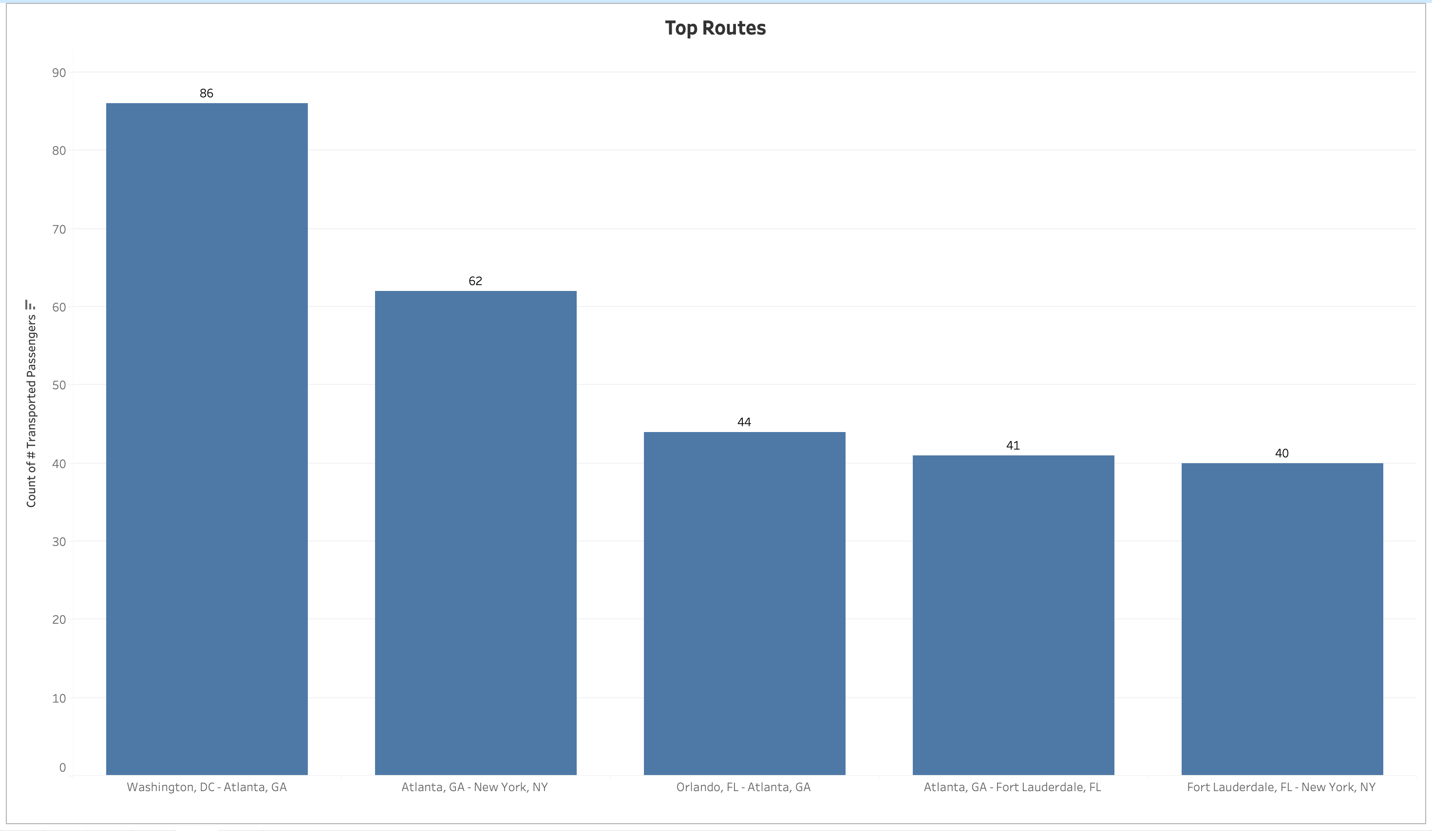
KPI 5 – Tableau - Top Routes based on Number of Flights

Slide 12
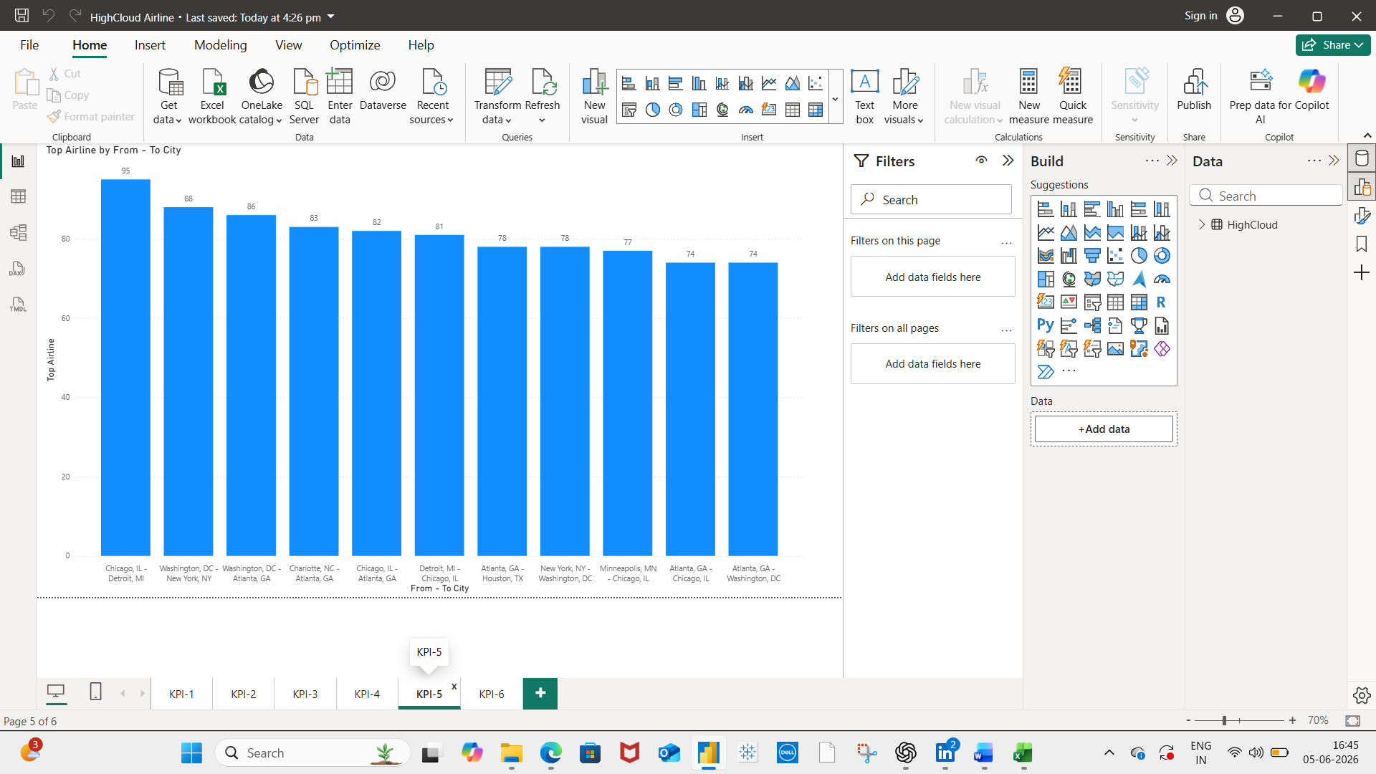
KPI 5 – Power BI - Top Routes based on Number of Flights

Slide 13
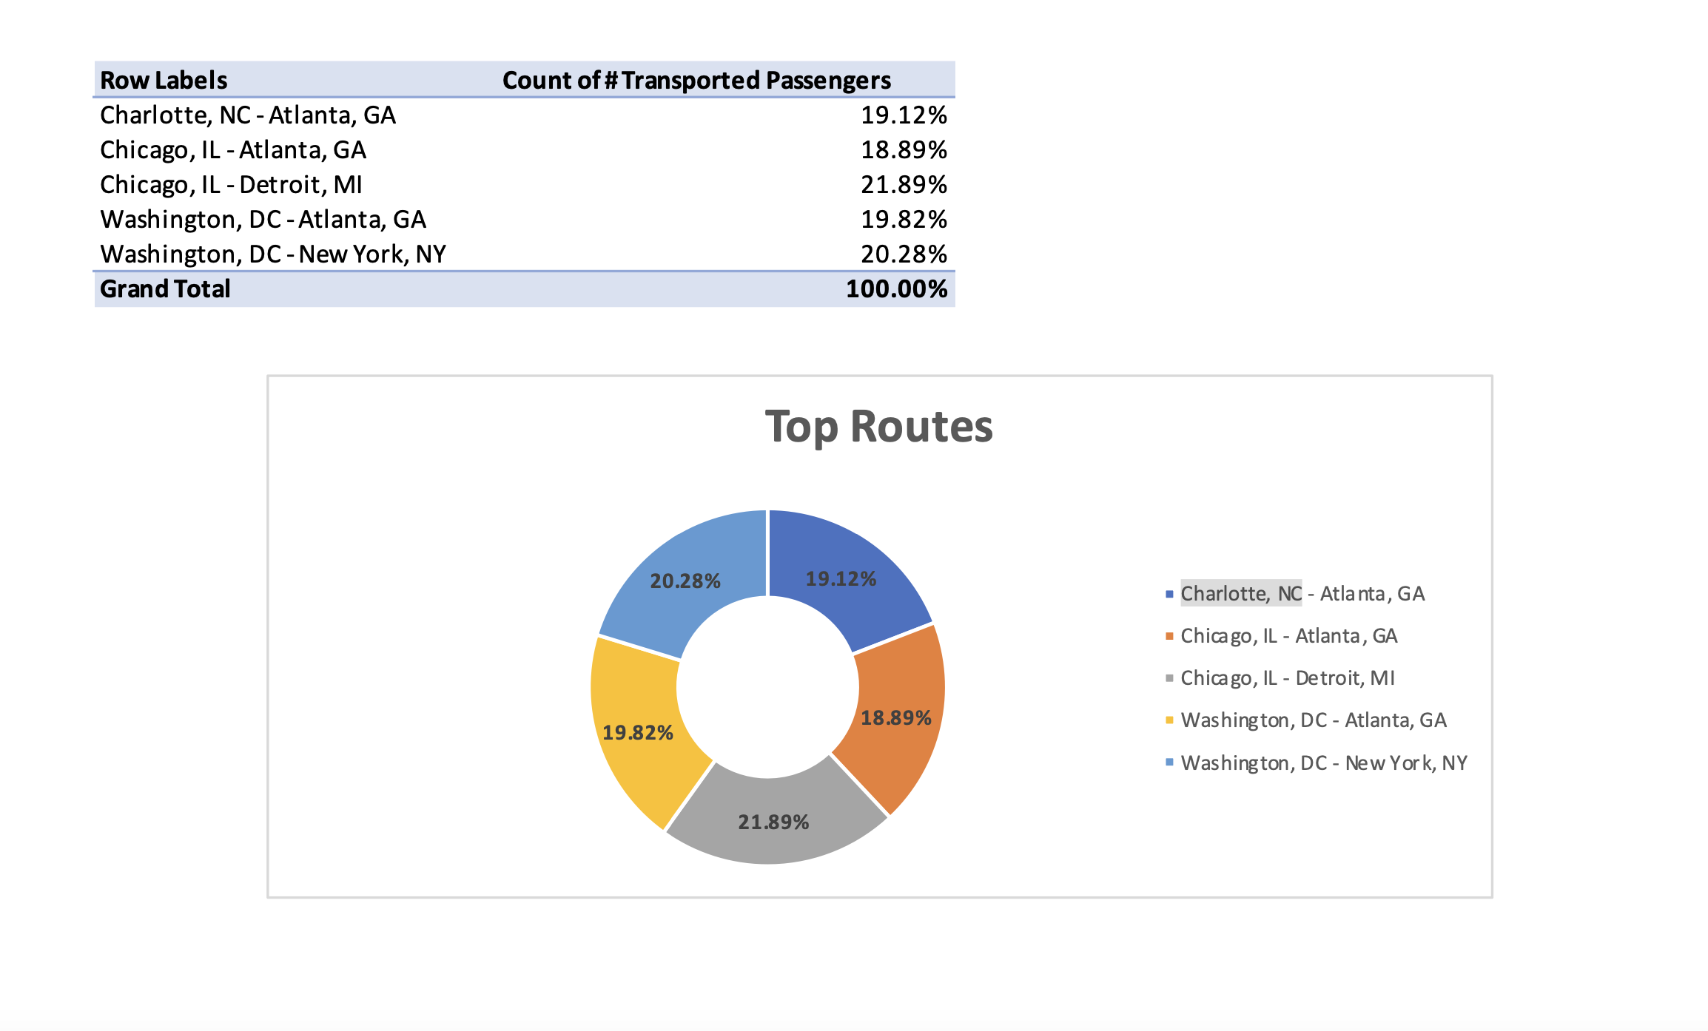
KPI 5 – MS Excel - Top Routes based on Number of Flights

Slide 14
KPI 5 – Findings - Top Routes based on Number of Flights
The route analysis identified the most frequently operated routes based on the total number of flights between origin and destination cities. The top routes accounted for a significant share of the airline's operations, indicating high passenger demand and strong connectivity between these city pairs.
Routes with the highest flight frequencies represent key travel corridors and strategic markets for the airline. These routes contribute substantially to network utilization, revenue generation, and passenger movement. The analysis also highlights cities that serve as major hubs within the airline network.
Understanding the most active routes enables management to optimize fleet allocation, improve scheduling efficiency, and support future route expansion decisions. High-frequency routes may present opportunities for increased capacity, while lower-frequency routes can be evaluated for performance improvement.

Slide 15
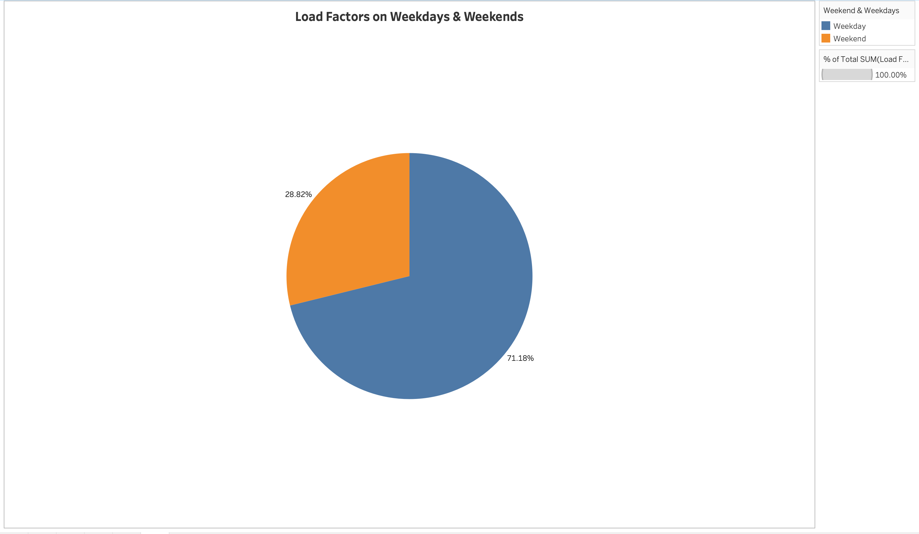
KPI 6 – Tableau - Load factor on Weekend vs Weekdays

Slide 16
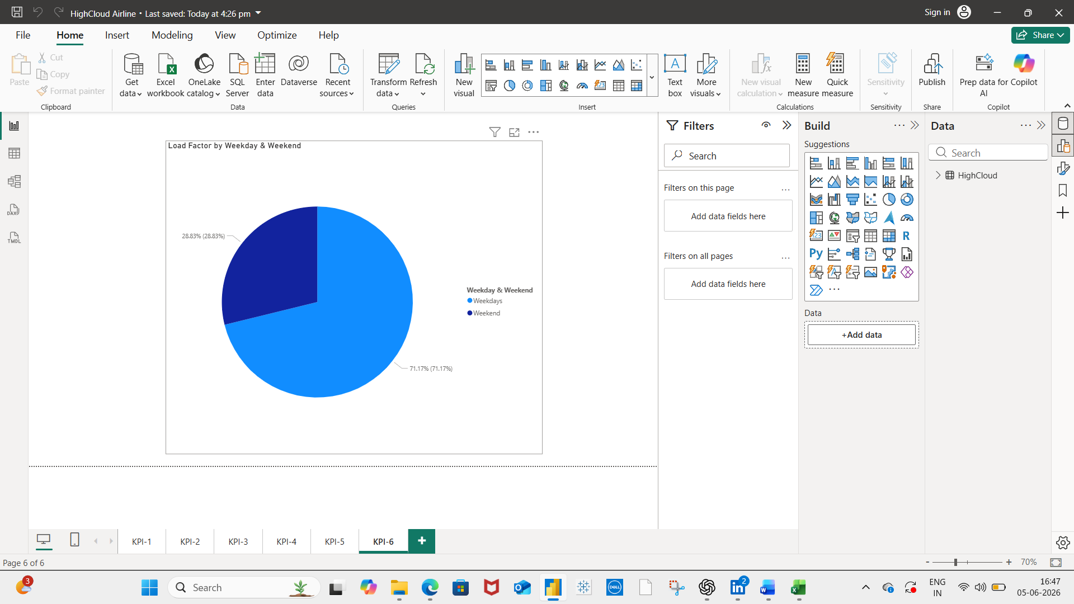
KPI 6 – Power BI - Load factor on Weekend vs Weekdays

Slide 17
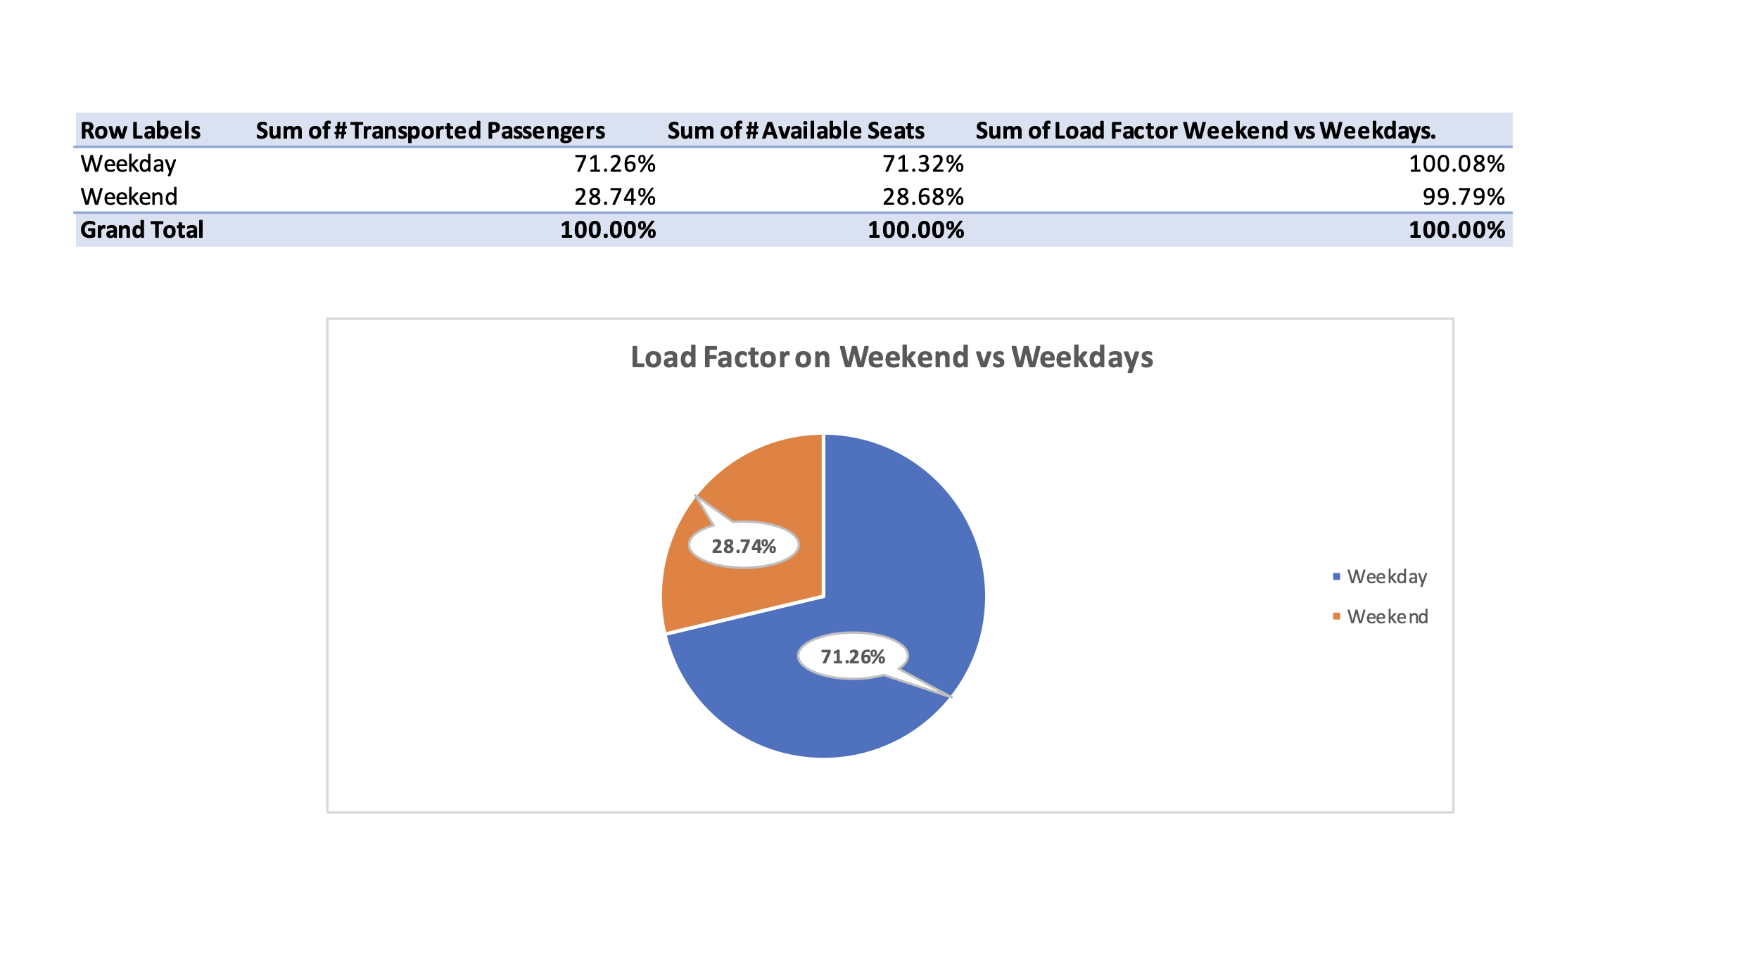
KPI 6 – MS Excel - Load factor on Weekend vs Weekdays

Slide 18
KPI 6 – Findings – Load factor on Weekend vs Weekdays
The analysis compared load factor percentages between weekends and weekdays to understand passenger travel patterns and seat utilization. Load Factor was calculated as the ratio of transported passengers to available seats.
The results indicate that passenger occupancy varies between weekends and weekdays, reflecting differences in business and leisure travel demand. Higher load factors on weekends suggest increased leisure and personal travel activity, while stronger weekday load factors may indicate a larger share of business-related travel.
This comparison helps the airline identify peak travel periods, optimize flight schedules, improve capacity planning, and implement targeted pricing strategies. Understanding these demand patterns enables better resource allocation and enhances overall operational efficiency.

Slide 19
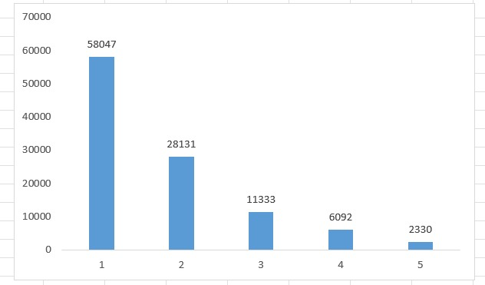
KPI 7 – MS Excel - Number of flights based on Distance group

Slide 20
KPI 7 – Findings – Number of Flights based on Distance group
Distance Group 1 recorded the highest number of flights with approximately 58,047 flights, followed by Distance Group 2 with around 28,131 flights. This indicates that short-distance routes contribute the largest share of airline operations and passenger movement within the dataset.
Flight frequency decreases gradually as the travel distance increases. Medium-distance groups such as Distance Group 3 and 4 recorded around 11,333 and 6,092 flights respectively, while higher distance groups had significantly fewer flights. This shows that airlines operate fewer long-haul routes compared to regional and domestic routes.
The findings highlight that airline operations are primarily concentrated on short and medium-haul travel. Long-distance groups such as Distance Group 8, 9, and 10 recorded relatively low flight counts, indicating lower operational frequency for long-haul travel and stronger demand for regional connectivity.

Slide 21
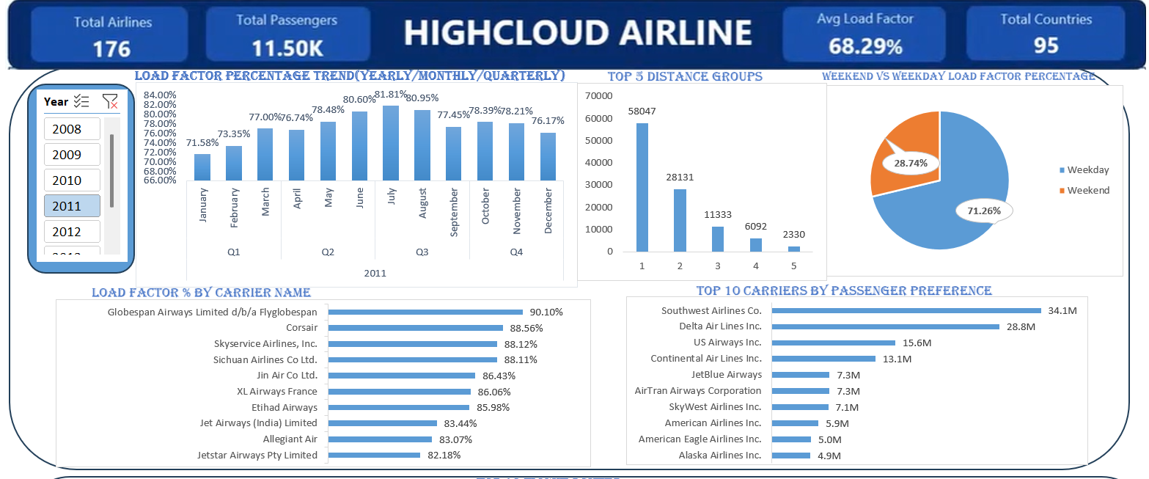
EXCEL DASHBOARD

Slide 22
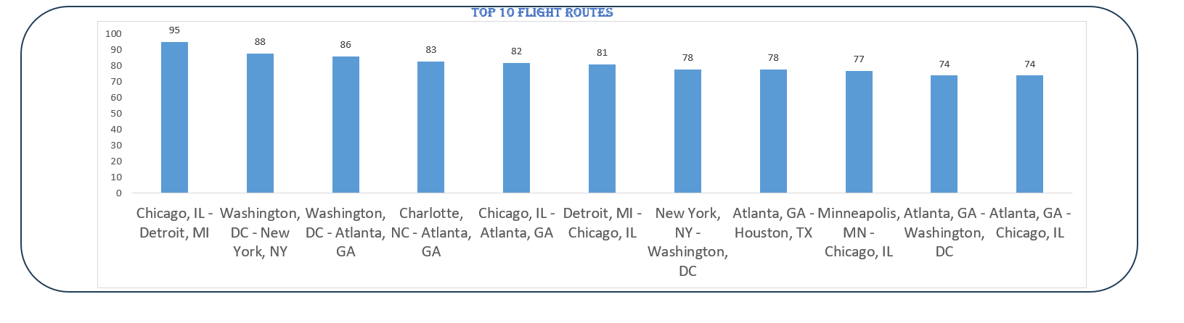
EXCEL DASHBOARD

Slide 23
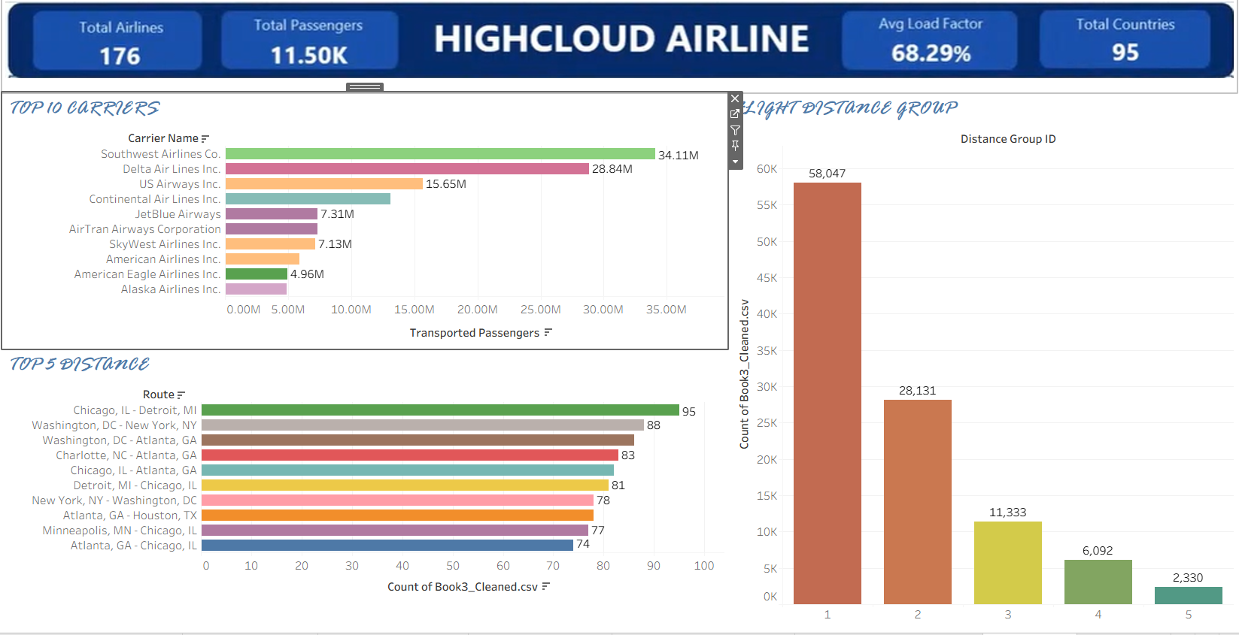
TABLEAU DASHBOARD

Slide 24
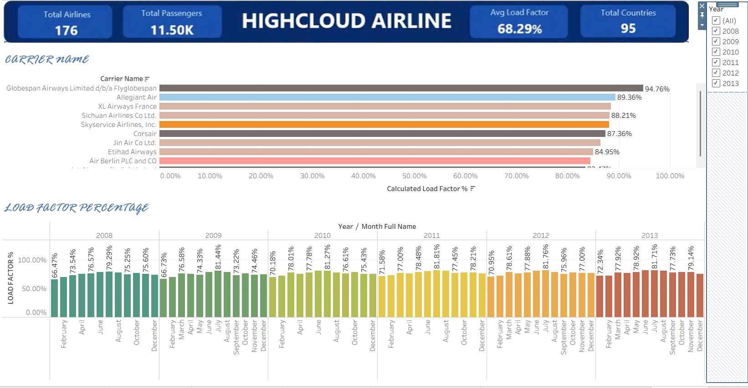
TABLEAU DASHBOARD

Slide 25
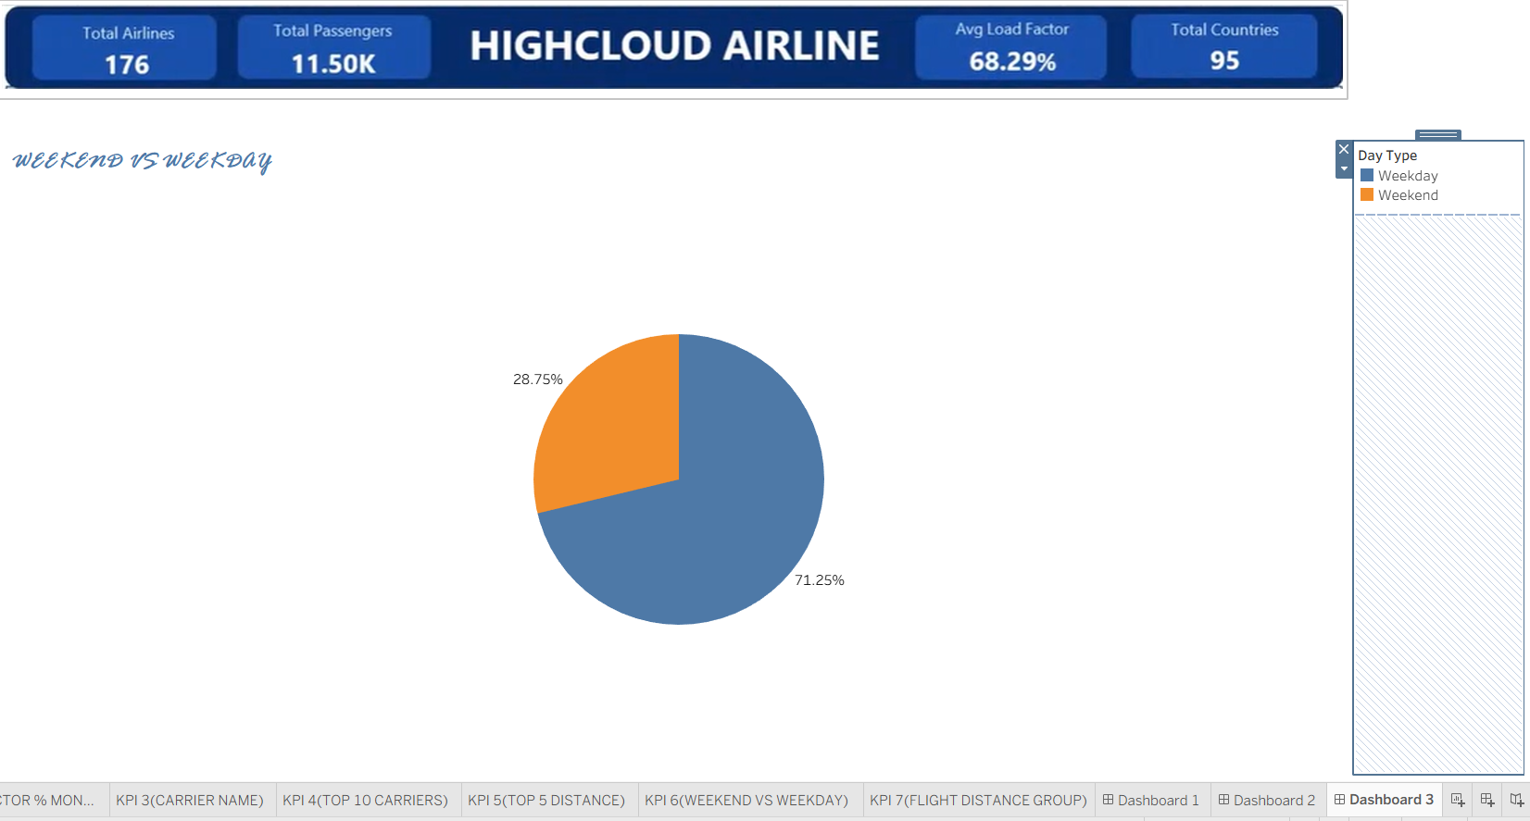
TABLEAU DASHBOARD

Slide 26
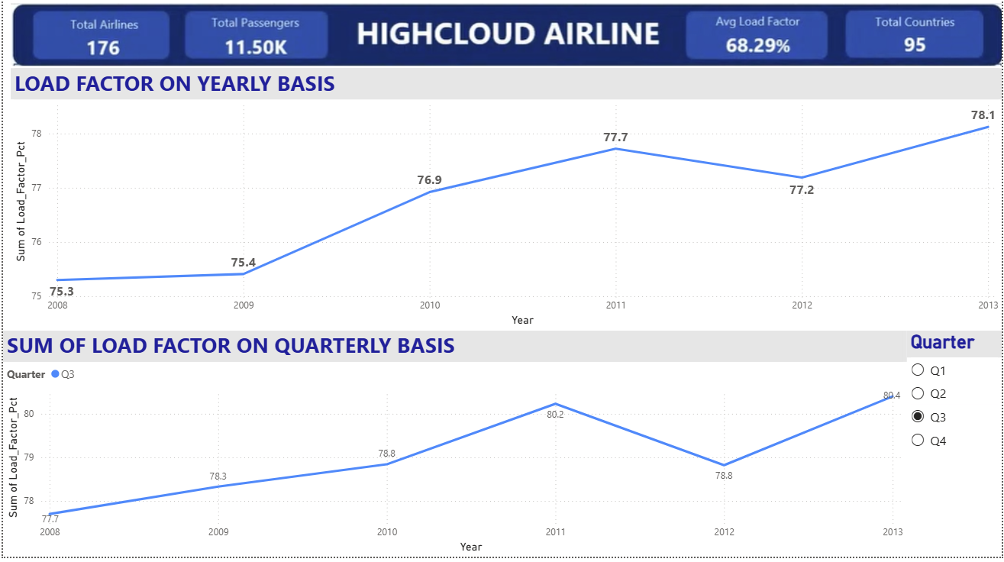
POWER BI REPORT

Slide 27
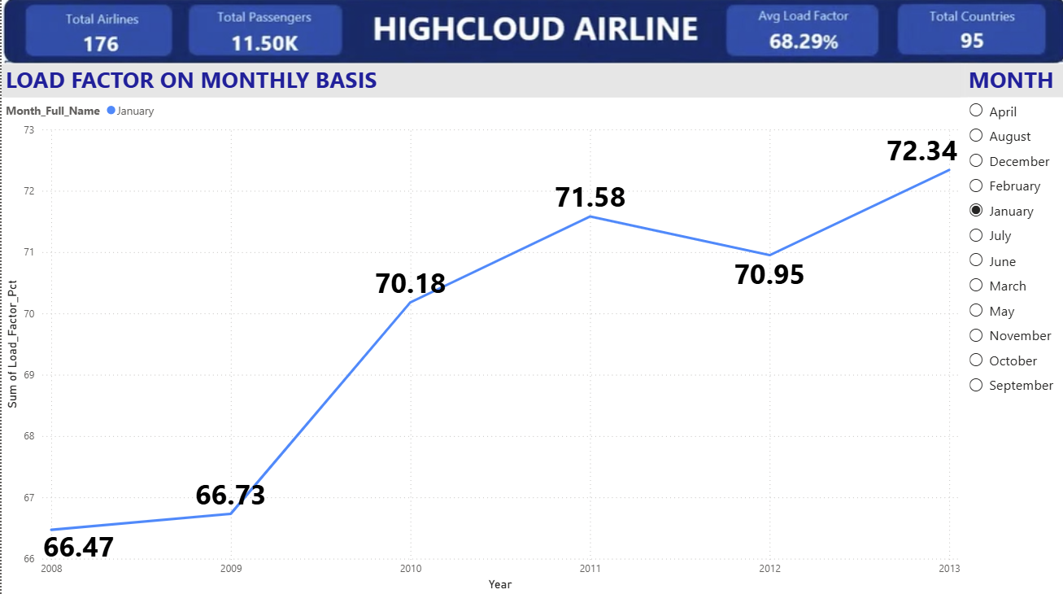
POWER BI REPORT

Slide 28
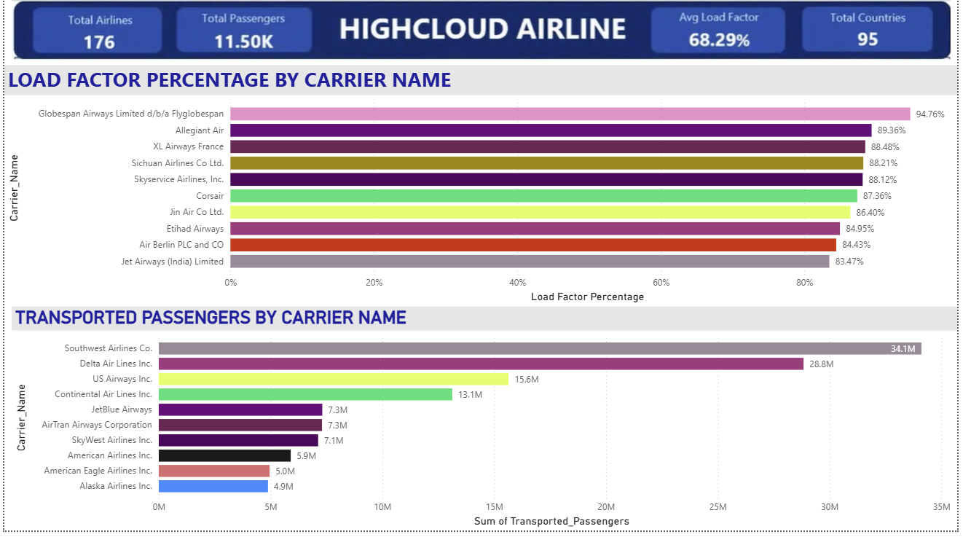
POWER BI REPORT

Slide 29
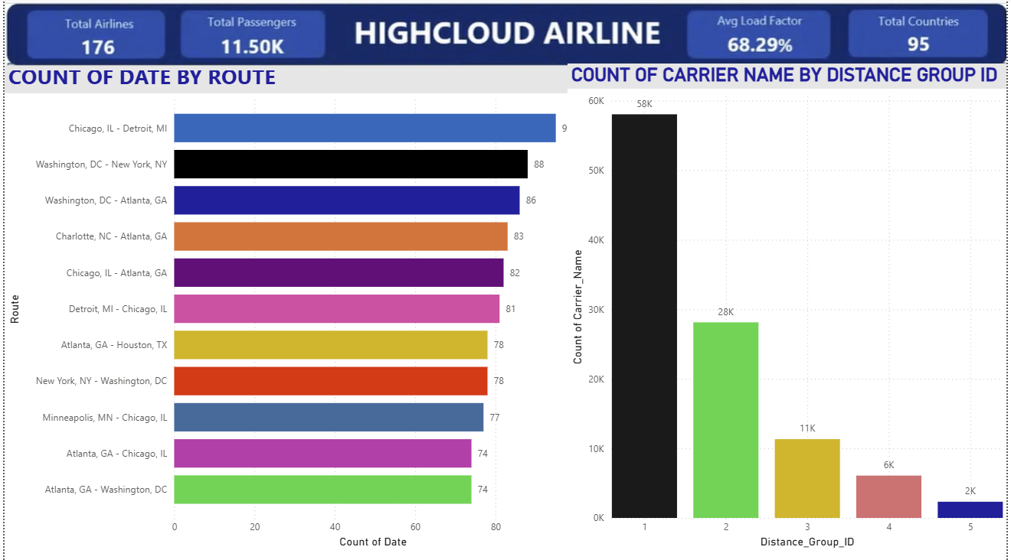
POWER BI REPORT

Slide 30
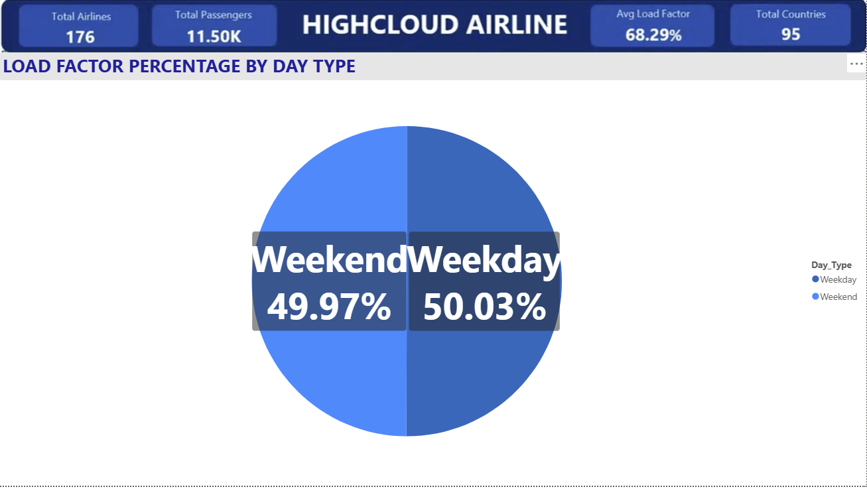
POWER BI REPORT

Slide 31
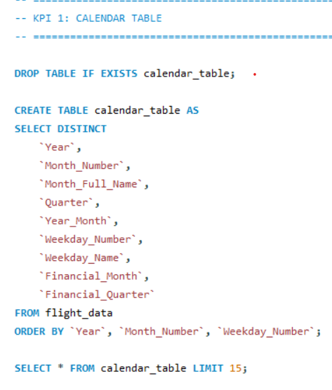
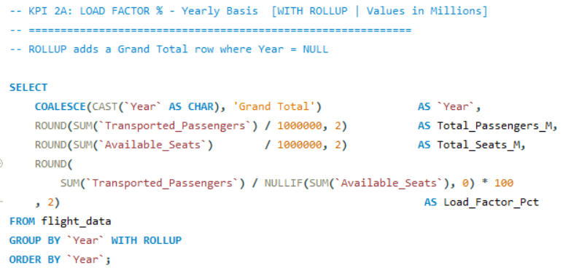
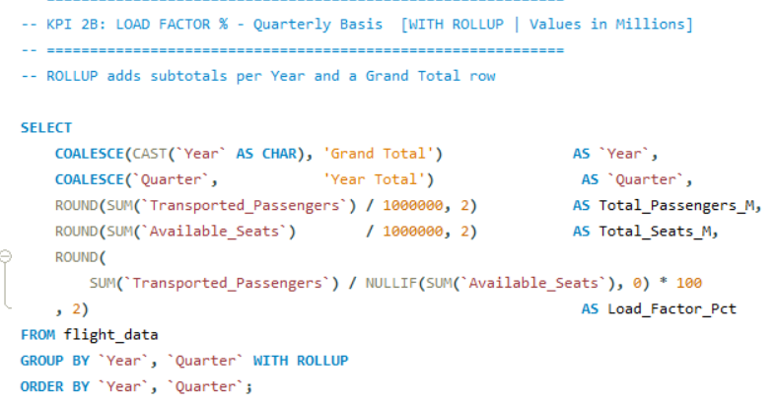

Slide 32
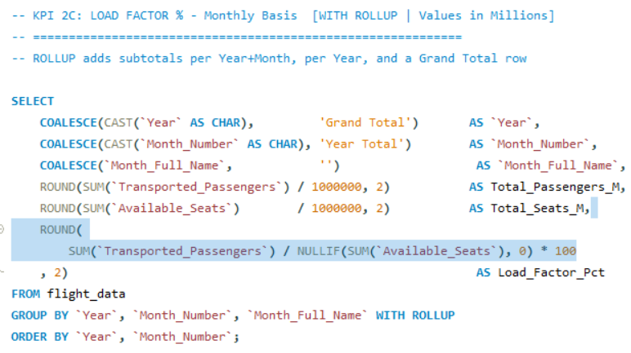
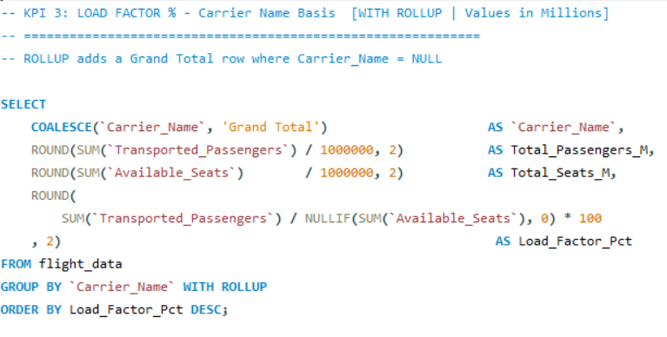

Slide 33
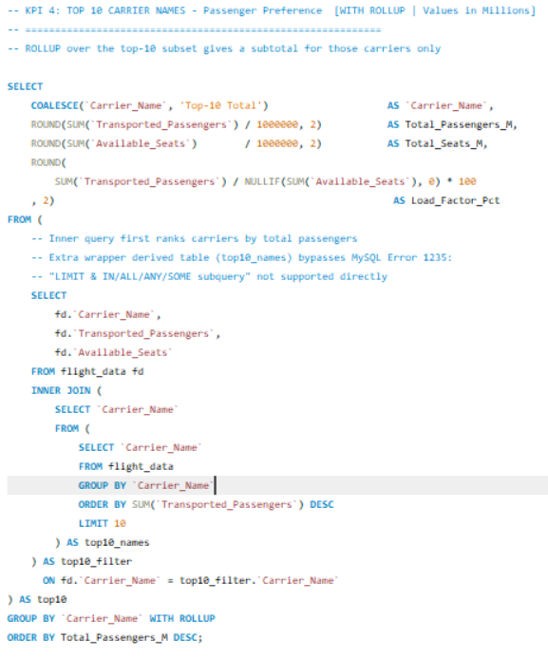

Slide 34
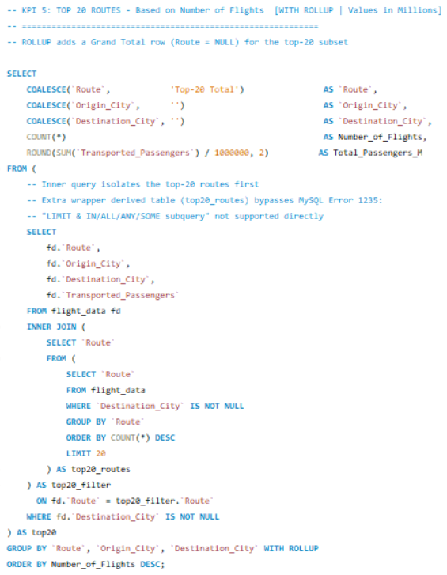
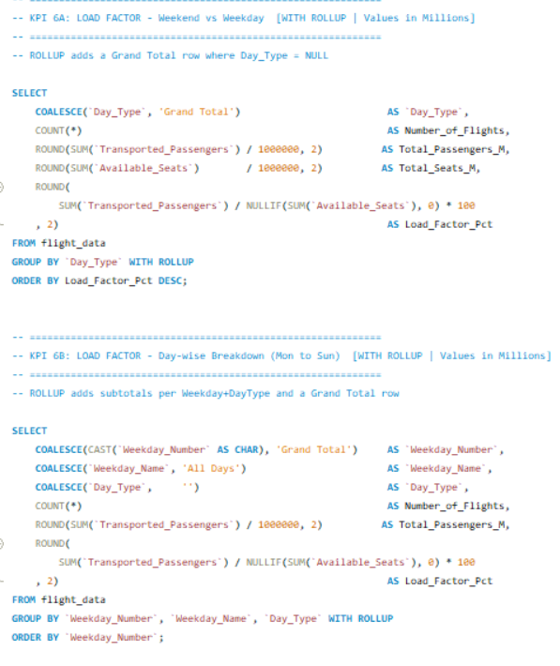

Slide 35
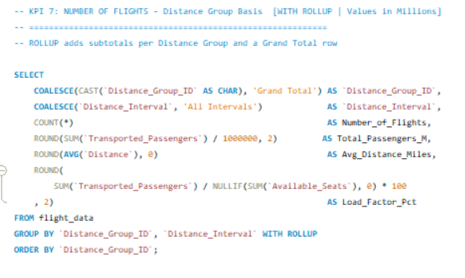

Slide 36
HIGH CLOUD AIRLINES
Full KPI Analysis
KPI 1 · KPI 2 · KPI 3 · KPI 4 · KPI 5 · KPI 6 · KPI 7
Challenges · Strategies · Conclusion
2008–2013 Dataset | Comprehensive Presentation

Slide 37
⚡ Challenges — KPI 1 to KPI 4
KPI 1 — Calendar Table
KPI 2 — Load Factor Trends
KPI 3 — Carrier Load Factor
KPI 4 — Top Carriers Volume
Zero gaps in 110,849-row date spine across 6 years
Financial year (April-start) needed CHOOSE-based formulas
WEEKDAY mode selection — wrong mode silently corrupts KPI 6
Weighted avg essential — simple mean of % would mislead
Quarterly/monthly splits fully depend on accurate KPI 1 dates
Validating 11.39pp seasonal swing as real vs data anomaly
209 carriers inc. FedEx/UPS at 0% — IFERROR critical
Charter vs scheduled mix distorts carrier benchmarking
93.47pp spread (1.29%–94.76%) complicates rankings
Delta 2010 jump (3.32M→5.72M) looked like error, needed verification
Merger-era codes risked double-counting passenger volumes
6-yr total vs annual peak — methodology choice altered rankings

Slide 38
⚡ Challenges — KPI 5 to KPI 7
KPI 5 — Top Routes by Flights
KPI 6 — Weekday vs Weekend LF
KPI 7 — Flights by Distance
Route deduplication: A→B vs B→A treated as one pair across 6 yrs
City/airport naming inconsistencies created duplicate route entries
Total flights vs annual average ranking — multiple iterations needed
100% dependent on KPI 1 — date errors cascade into LF split
Daily vs weekly aggregation produced different results — needed consistent method
Holiday Mondays & Friday surges distorted weekday average
Industry-standard bin boundaries needed — not arbitrary mileage cuts
Group 1 concentration (58,047 flights) made charts appear lopsided
Cost implications required supplementary data not in primary dataset

Slide 39
🎯 Strategies — KPI 1 to KPI 4
KPI 1 — Time Intelligence
KPI 2 — Capacity Planning
KPI 3 — Benchmarking
KPI 4 — Market Positioning
Automate calendar refresh for datasets extending beyond 2013
Add rolling 12-month view using financial quarter fields
Build scheduling alerts for historically low-demand calendar periods
Reduce capacity in Q1 (weak); expand inventory in Q3 (peak 80.40%)
Target 79–80% annual LF using tighter seat release curves Jun–Aug
Combat Jan trough (69.80%) via promos, loyalty & leisure partnerships
Benchmark vs Allegiant (89.36%) & Etihad (84.95%) for LF discipline
Set LF floor: routes below 70% for 2 qtrs → review or downsize
Avoid flying routes that can't break even on load factor
Target corridors underserved by top-4 (SW + Delta = 33.66% share)
Study Southwest's high-freq & Delta's merger rebound as growth models
Pursue SkyWest-style codeshares for network scale without capex

Slide 40
🎯 Strategies — KPI 5 to KPI 7
KPI 5 — Route Optimisation
KPI 6 — Pricing & Fleet
KPI 7 — Network by Distance
Increase frequency on top hub-to-hub routes during peak demand windows
Deploy dedicated aircraft for busiest corridors to cut per-seat cost
Codeshare / interline on moderate-traffic routes for low-cost reach
Dynamic weekend pricing on leisure-heavy routes to capture inelastic demand
Corporate loyalty packages to keep weekday occupancy consistently above 75%
Right-size fleet: smaller efficient aircraft on lower-demand weekday departures
Invest in short-haul turnaround infra (gates, crew, ground) for Dist. Group 1
Expand medium-haul selectively on underserved city pairs with demand signals
Long-haul must pass strict RASM/CASM profitability gate before capital commitment

Slide 41
📊 Key Data Highlights — 2008–2013
78.12%
94.76%
34.1M
58,047
Peak Annual
Load Factor
Top Carrier LF
(Globespan)
Southwest
Passengers
Dist. Group 1
Flights
Up from 75.30% in 2008
Best-in-class benchmark
#1 carrier, 18.24% share
Largest distance segment
80.40%
+2.82pp
187M
~49%
Q3 2013 Peak LF
LF Improvement
2008–2013
Total Top-10
Passengers
Top-4 Carrier
Market Share
Highest single quarter
Capacity discipline
2008–2013 combined
Oligopolistic structure

Slide 42
✅ Conclusion — Integrated Insights Across All 7 KPIs
The Invisible Backbone
Find the Gaps the Giants Miss
KPI 1
KPI 4
Without a trusted calendar table, no KPI is reliable. Build it right, automate it, and all analytics flow from it.
Top-4 own 49% of volume — underserved corridors and codeshare opportunities provide strategic growth room.
Seasonal Discipline Wins
Concentrate, Don't Spread Thin
KPI 2
KPI 5
LF grew 75.30%→78.12% over 6 years. Act on the Q1 trough and Q3 peak with proactive capacity & yield management.
A few hub-to-hub routes drive the bulk of traffic. Do fewer routes exceptionally well for maximum ROI.
Benchmark Up, Not to Average
Price for Each Segment
KPI 3
KPI 6
Allegiant (89.36%) proves disciplined seat release beats flying with empty rows. Set floors, not just targets.
A healthy weekday/weekend LF balance enables dynamic pricing strategies without cannibalising either demand pool.
KPI 7: Short-haul is the Core Engine — invest in Distance Group 1 infrastructure to underpin the entire network's profitability

